Slide 1
DBMS in Booking.com
15146325 Wonho Choi
16102273 Jihye Ryu
16102280 Heejin Son
17102054 Ingyun Ahn

Slide 2
Contents
1. Description of Project
2. How to obtain the data
3. How to model and handle the database
4. How to interact webpage with database
5. Final Result of Implementation

Slide 3
Description of Project
“How to recommend the place matching to the period?”
Main functionality
Users can get the lists of the top 3 popular places at the time they want to travel.
Users can get the top 3 ranked popular city in that period.
Users can get recommendation about the most popular type of accommodation in the top 3 city.
Users can get recommendation about the most common type of journey in top 3 city.

Slide 4
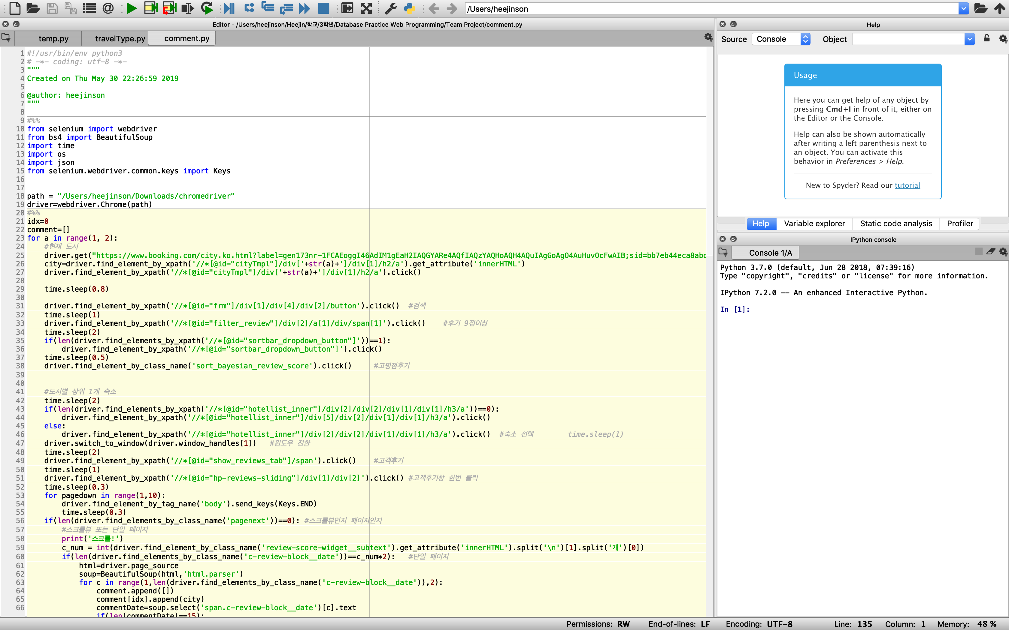
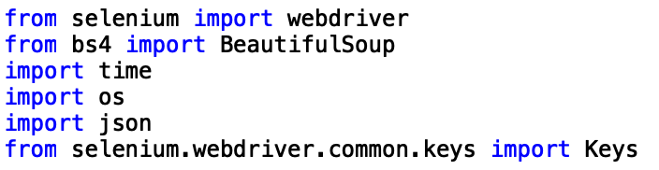
How to obtain the data
To scrap enormous amounts of data, we make the automation code for webpage to get the appropriate information.
To make the webdriver get the page, click automatically, and get the information on the web page, we programmed in python with Selenium, and beautifulsoup.

Slide 5
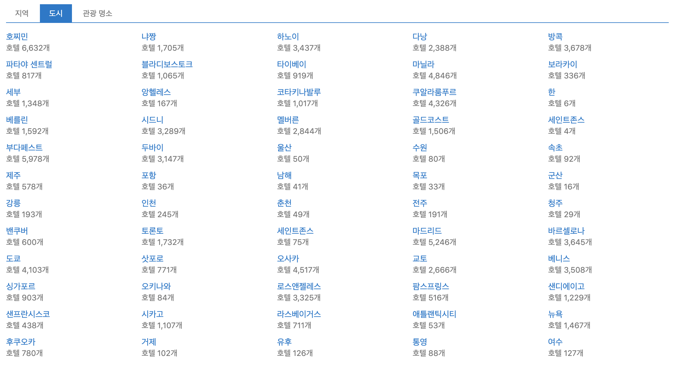
How to obtain the data
We limits the cities we get the information from with the city list the booking.com provides.
→ We store 199 cities all around the world.

Slide 6
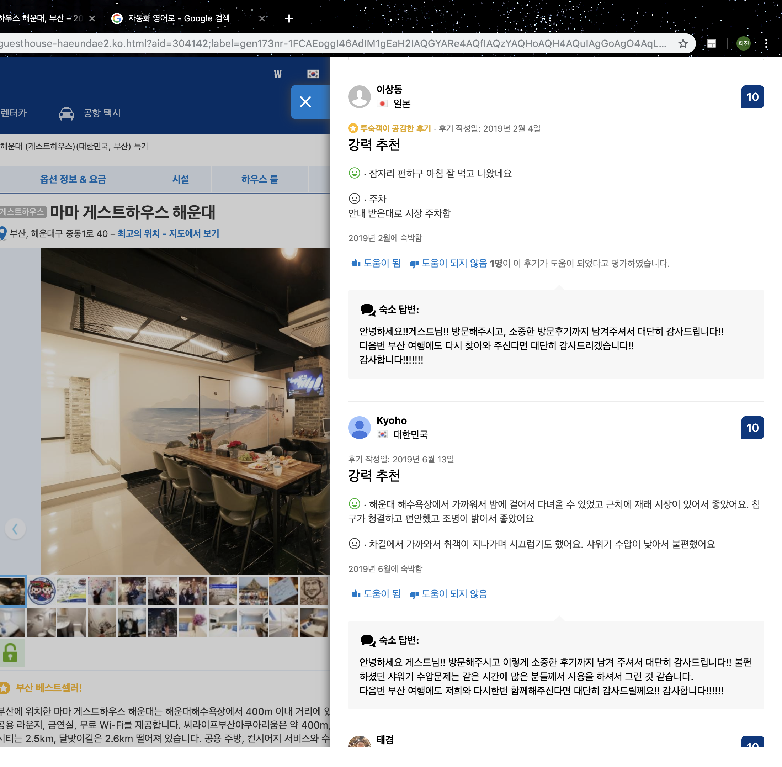



How to obtain the data
To get the most popular city,
we collect the comments that the visitors made.
Only the real visitors who stayed in the hotel within 1 month can make the comment.
And to provide the recommendation corresponding to the month, we collect the comments date data which has the information when visitors visited.

Slide 7
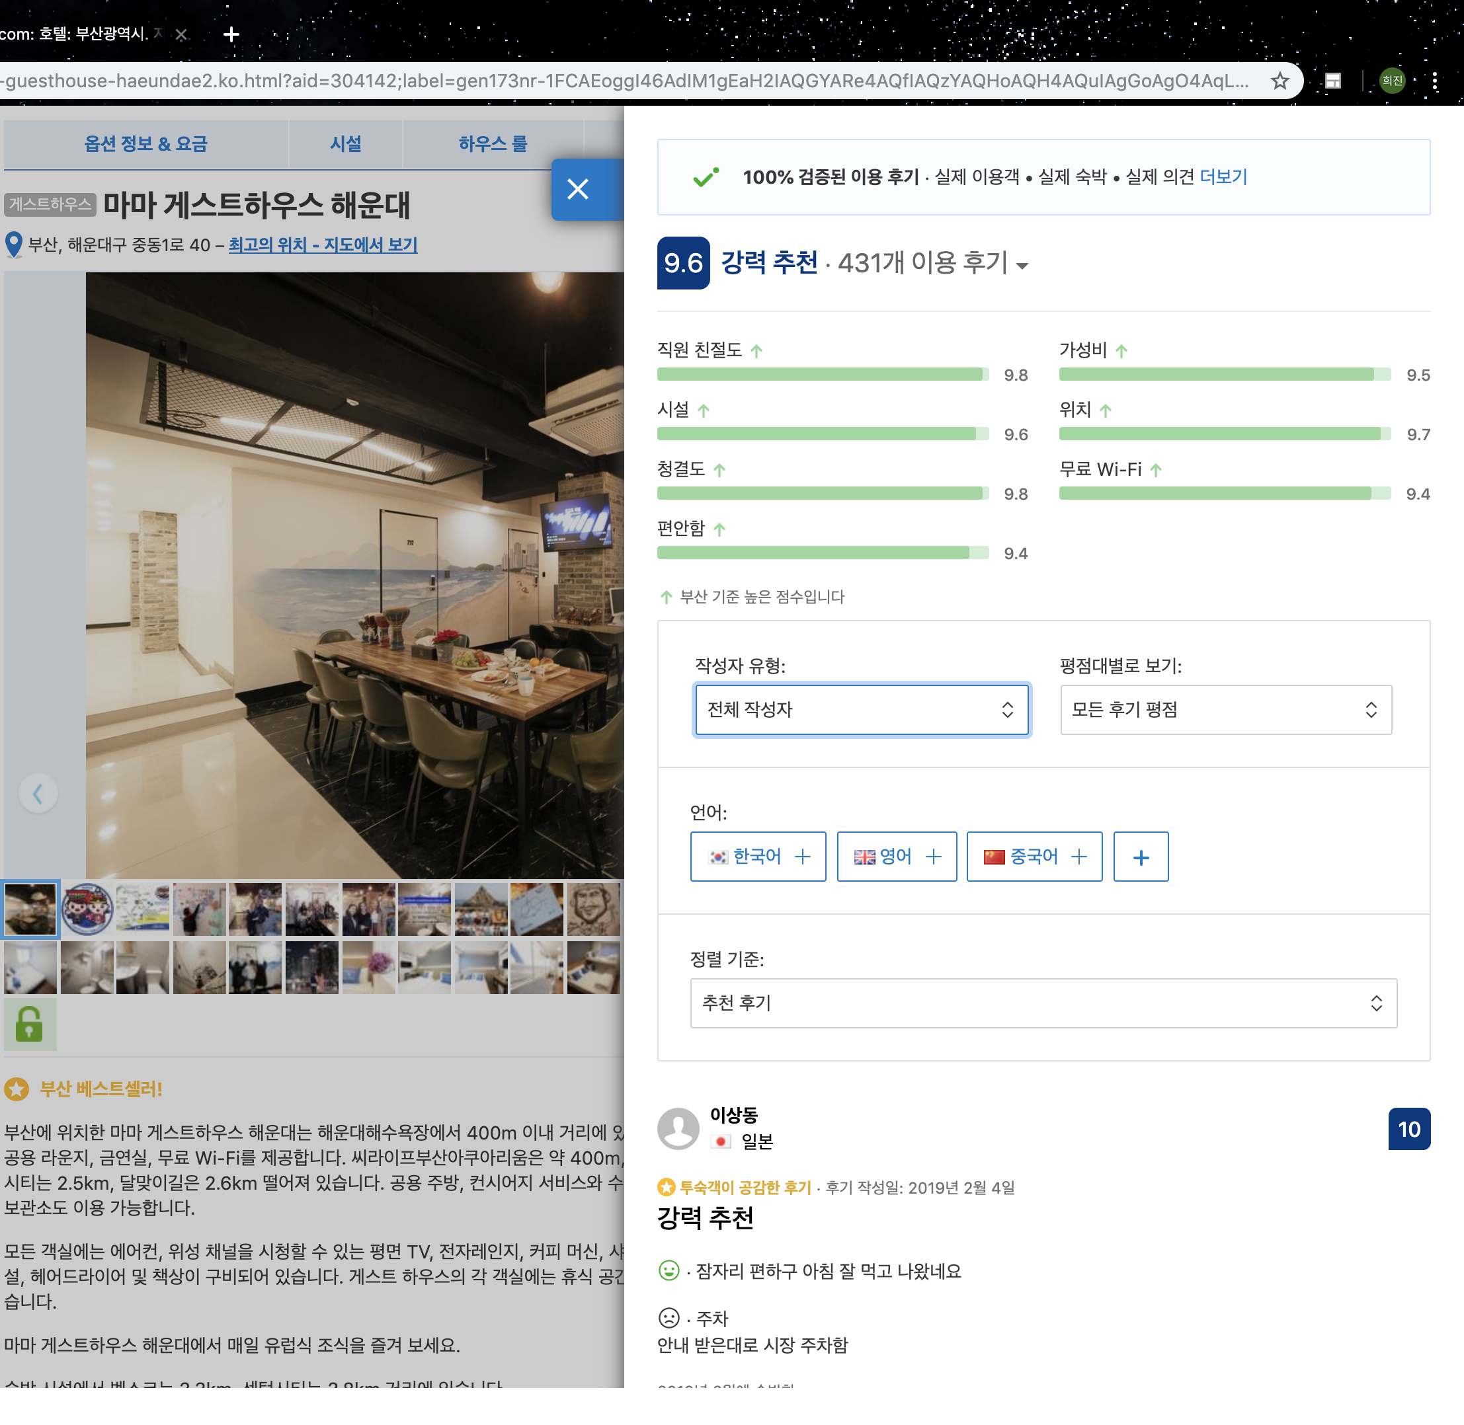
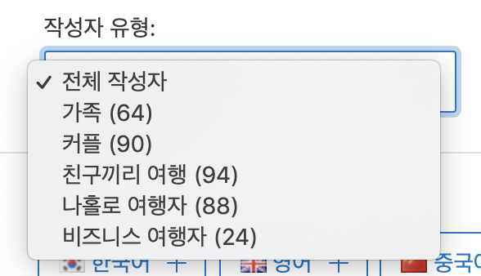
How to obtain the data
To get the most popular journey type,
we collect the information about the type of commenters.
There are 5 types of visitors:
Family with children
Couple
Friends
Solo traveler
Business traveler
And to provide the most popular type of travel in that city, we count the number of type of visitors in each cities.

Slide 8
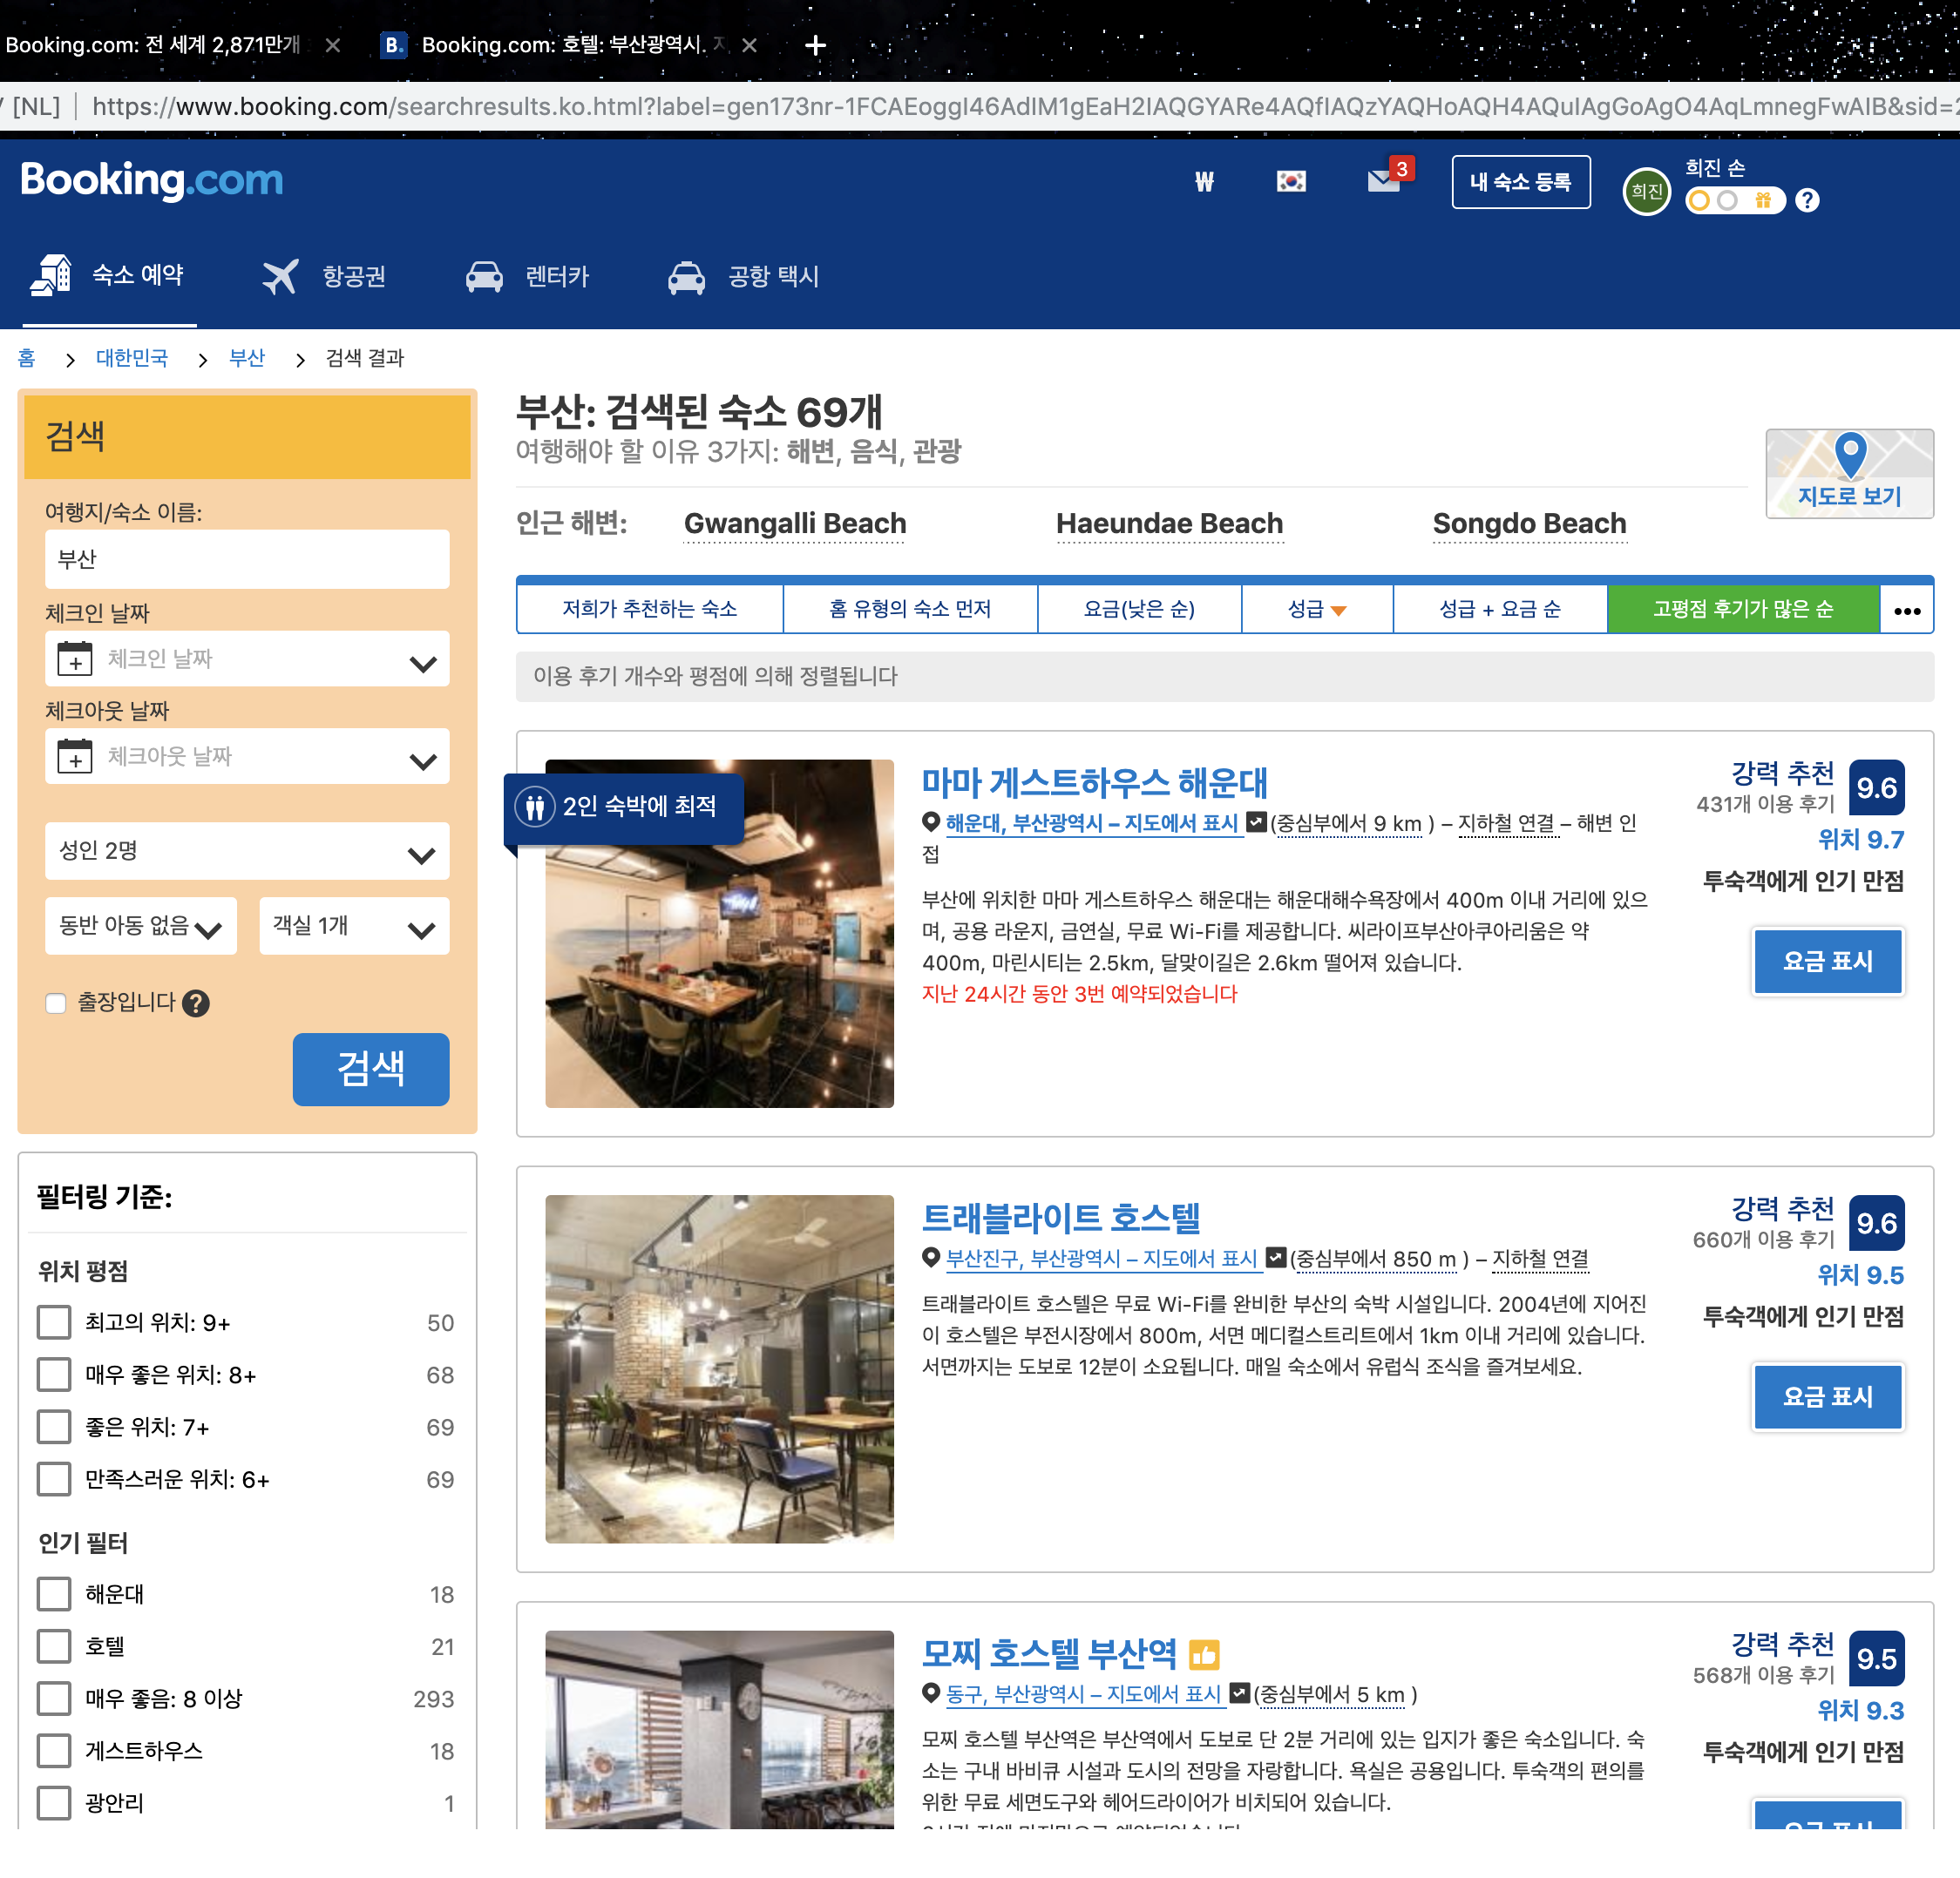
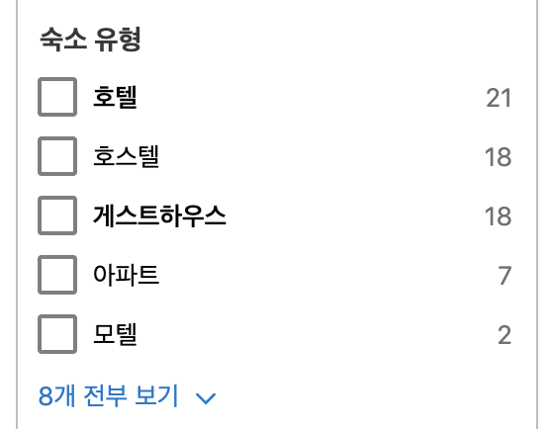
How to obtain the data
To get the most popular type of accommodations,
we collect the information about the type of accommodations.
There are many types of accommodations:
Hotel
Hostel
Guest House
Apartment
Motel
Etc
And to provide the most popular type of accommodations in that city, we get the number of the accommodations of each city in the page.

Slide 9
How to model and handle the database
Database used : MySQL
4 Tables in Database
CITY
ACCOMMODATION
COMMENT
TRAVELTYPE

Slide 10
How to model and handle the database
Detailed Schema
Database “TravelMaker”
CITY
ACCOMMODATION
COMMENT
TRAVELTYPE
• Id
• CityName
• Id
• AccommoType
• NumOfCase
• Id
• Month
• Id
• Family
• Couple
• Friends
• Solo
• Business

Slide 11
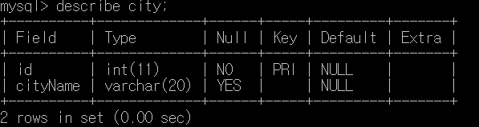
How to model and handle the database
Detailed Schema
Database “TravelMaker”
CITY
ACCOMMODATION
COMMENT
TRAVELTYPE
2 Fields
199 Tuples

Slide 12
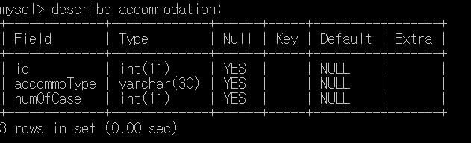
How to model and handle the database
Detailed Schema
Database “TravelMaker”
CITY
ACCOMMODATION
COMMENT
TRAVELTYPE
3 Fields
199 Tuples

Slide 13
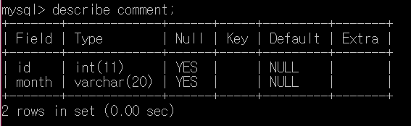
How to model and handle the database
Detailed Schema
Database “TravelMaker”
CITY
ACCOMMODATION
COMMENT
TRAVELTYPE
3 Fields
2 Fields
199 Tuples

Slide 14
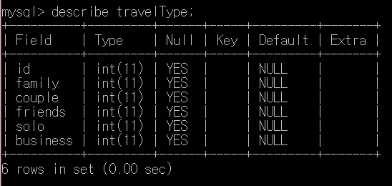
How to model and handle the database
Detailed Schema
Database “TravelMaker”
CITY
ACCOMMODATION
COMMENT
TRAVELTYPE
3 Fields
2 Fields
6 Fields
199 Tuples

Slide 15
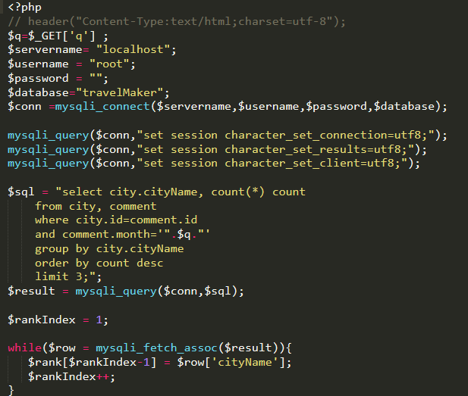
How to interact webpage with database
Detailed Code

Slide 16
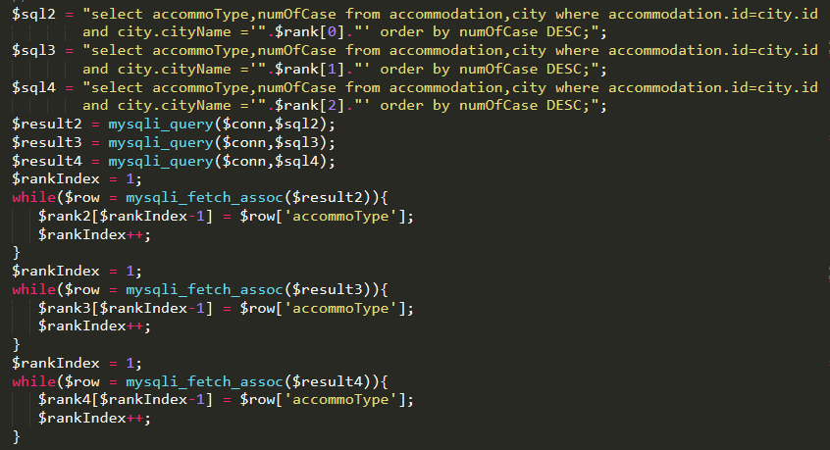
How to interact webpage with database
Detailed Code

Slide 17
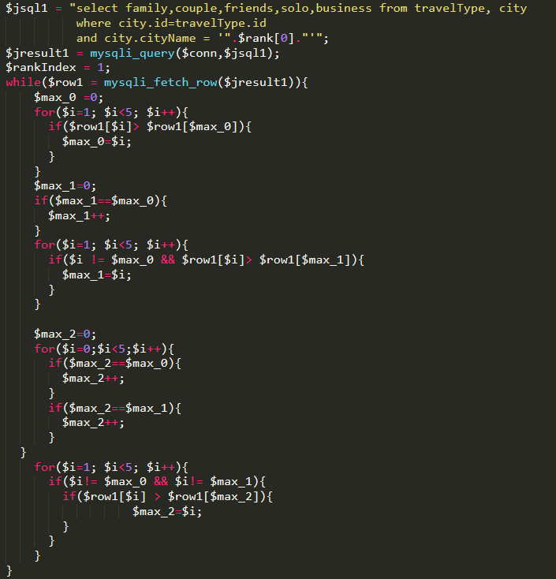
How to interact webpage with database
Detailed Code

Slide 18
Final Result of Implementation

Slide 19
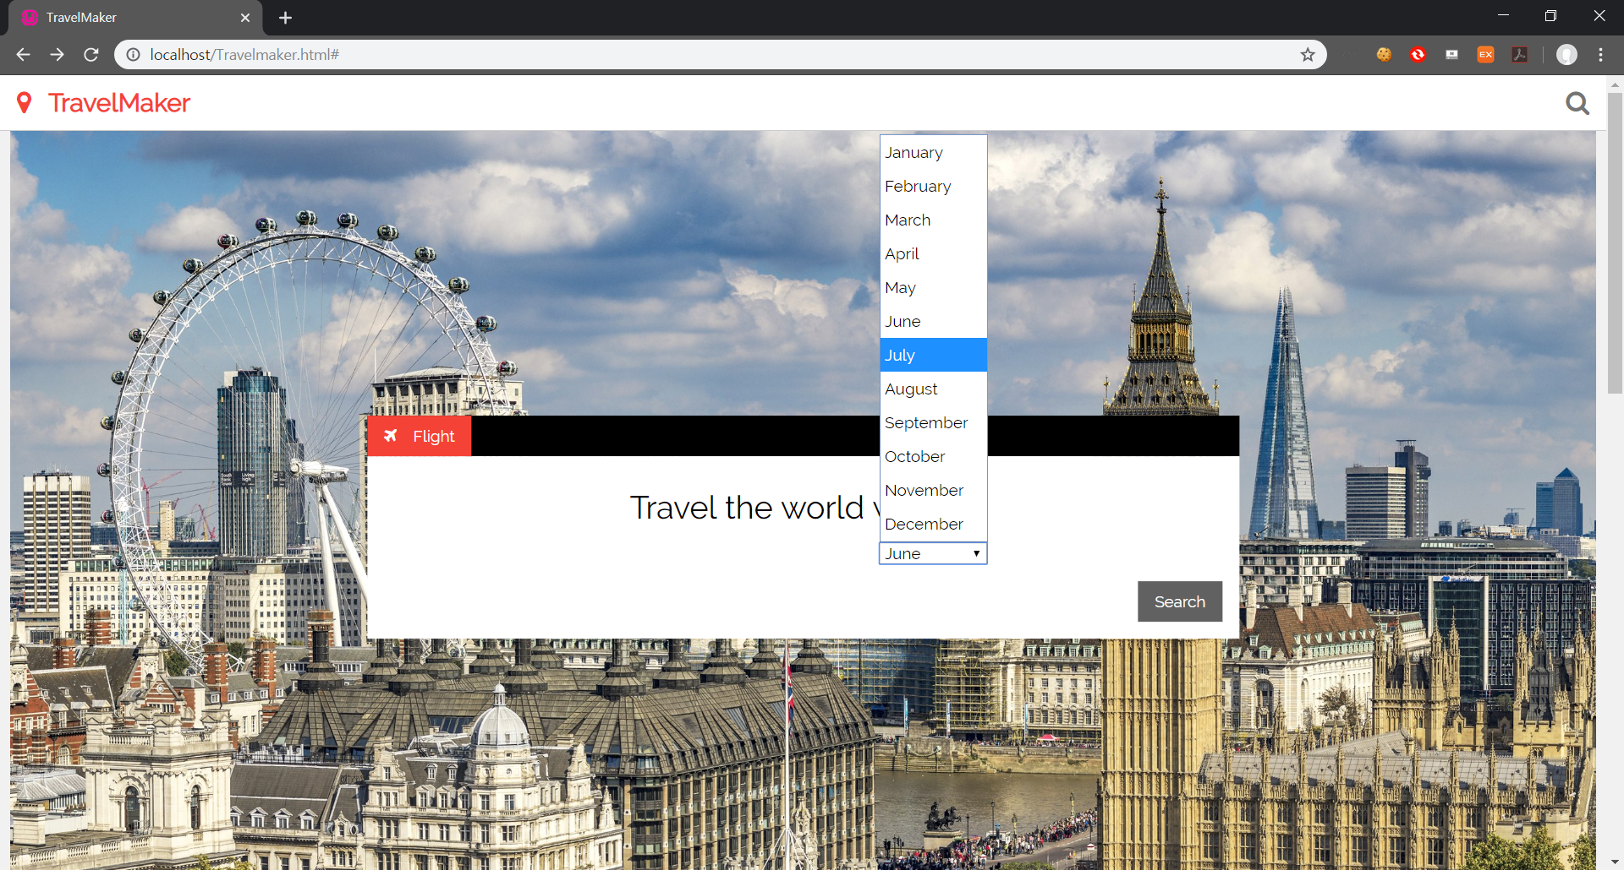
Final Result of Implementation

Slide 20
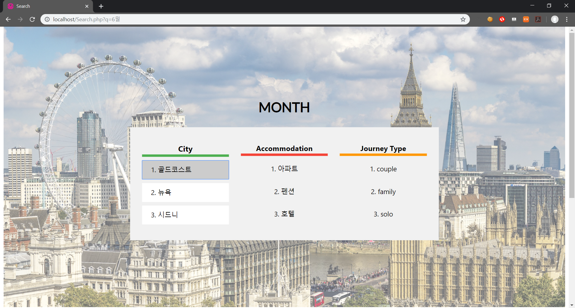
Final Result of Implementation

Slide 21
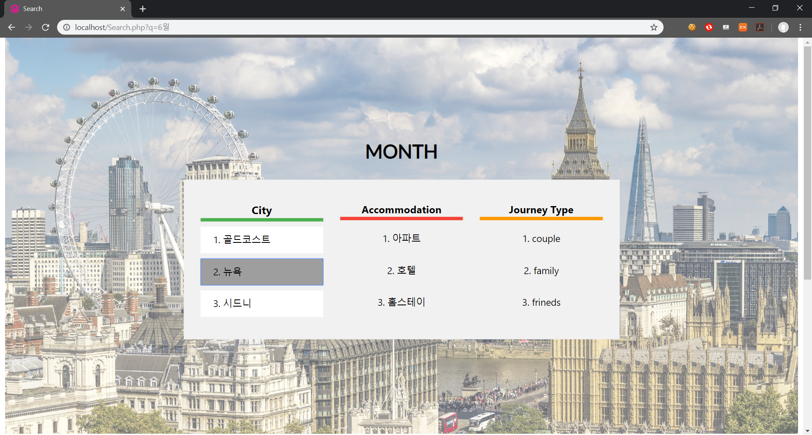
Final Result of Implementation

Slide 22
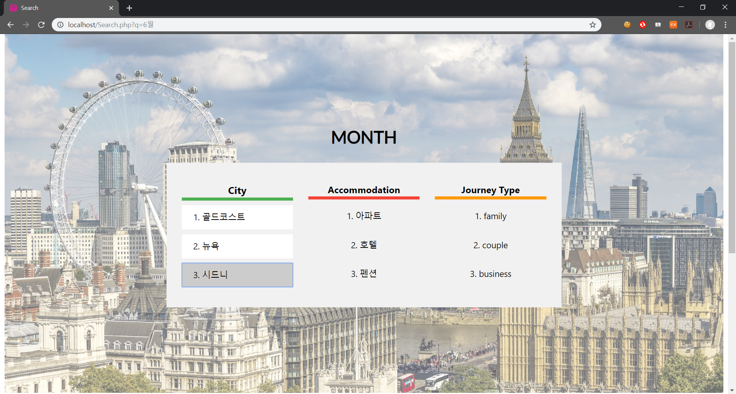
Final Result of Implementation

Slide 23


